Slide 1
Gaming Dataset Analysis
Exploring game ratings by release date
Prashil Patel
Notes:
Introduction
Why i chose this dataset
Interest, been around it since growing up
Everyone has experienced at some point in life
One of my major, if only hobby

Slide 2
Index
Overview (Business Problem/ Dataset)
Page 3
Business Question / Hypothesis
Page 4
Methods, Results and Findings
Page 5
Data Cleaning and Wrangling Process
Page 6
Exploratory Data Analysis
Page 7
Conclusions
Page 8
Bonus
Page 9
Future Improvements
Page 10
Prashil Patel
Notes:
Quick overview
Main overview - Business Problem and dataset
Business Question
Hypothesis generated
Methods, results and findings
1 sided t-test using sampling
Data Cleaning & Wrangling
EDA
Final Conclusion
Bonus graph
Future

Slide 3
Overview
Dataset Overview
Source: Kaggle (The data has been collected from a game log/recording site called backloggd.)
Simple data scraping tools have been used such as Beautiful Soup*.
1512 Samples, 13 Features
Features Used:
Title
Release Year (created column)
Release Date
Team
Rating
Genre
Business Problem
We need to determine whether video games released between 2001-2010 have significantly higher ratings than those released between 2011-2020. Understanding this trend will help us make informed decisions about game design, market preferences, and potential investment in specific genres or time periods.
*Beautiful Soup is a web page scraping tool package available in python which simplifies HTML and XML parsing.
Prashil Patel
Notes:
Business Problem:
Determine if games made/released in 2001-2010 are rated higher by players compared to release dates in 2011-2020
Helps future games make a better investment when creating new games.
Gives game designers an idea of market preferences
Dataset Overview:
Scrapped from backloggd using package called Beautiful Soup.
1512 Samples, 13 Features, (title, release year, release date, team, rating, genre) Features Used and why
*Beautiful Soup is a web page scraping tool package available in python which simplifies HTML and XML parsing.

Slide 4

Overview
Hypothesis
Null Hypothesis:
There is no significant difference in the average ratings of games released between 2001-2010 and 2011-2020
Alternative Hypothesis:
Games released in 2001-2010 have significantly higher ratings than those in 2011-2020.
Business Question
Do games released between 2001-2010 have a better player ratings compared to games released in 2011-2020 from backloggd.com.
Prashil Patel
Notes:
Business Question
Games released between 2001-2010 have a better player rating compared to games from 2011-2020 from backloggd.com
Hypothesis
Null: no significant difference
Alternative: 2001-2010 significantly higher
What we’re looking for means (how it helps answer our question):
If we get null, we can look at all the data
If we get alternative, we should look at games in 2001-2010

Slide 5
Methods Results and Findings
01
02
03
Methods
Results
Findings
Data was grouped and sampled
Alpha 0.05
Used a 1 sided t-test
Greater sided
Observe P-Value
T-Test: 2.521243380534123
P-value: 0.00624121392540133
P-Value is not greater than our Alpha.
In favour of the alternative.
Prashil Patel
Notes:
Data was grouped
Data was not originally distributed
Took a sample of 100 from each group
Used a one sided t-test as im looking for only the bigger ratings, not either or
T-test: 2.52
P-value: 0.006
T-test is big hence it suggests a noticeable difference in rating
We confirm this with P-value and alpha of 0.05 (95%)
P value is smaller than our alpha hence we strongly reject the null hypothesis in favour of the alternative

Slide 6
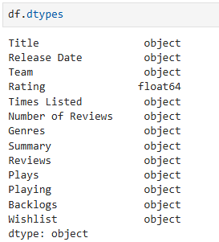
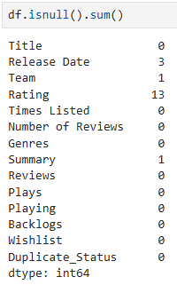
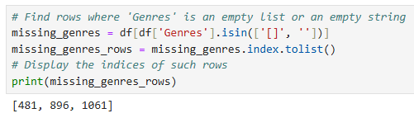
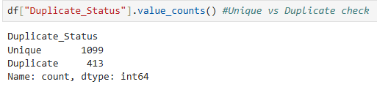
Data Cleaning and Wrangling
Prashil Patel
Notes:
During my data discovery found alot of issues to change:
Release date wrong type
Missing values
Catched genres not showing as null
Found duplicate rows
Changed release date to date/time
Removed release date rows
Changed Team null value
Filled ratings with mean values
Did not touch summary as not of importance
Rows with missing genre dropped
Duplicate rows dropped (could bias data)

Slide 7
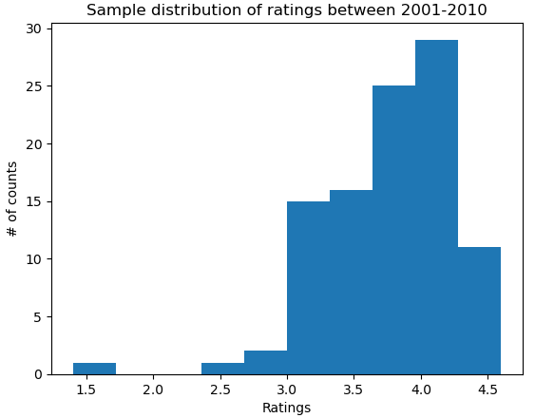
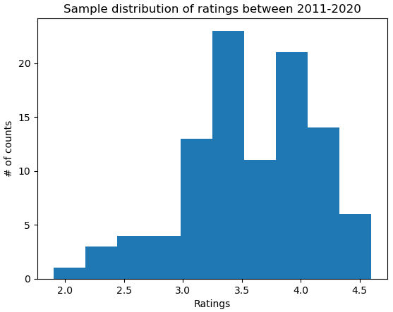
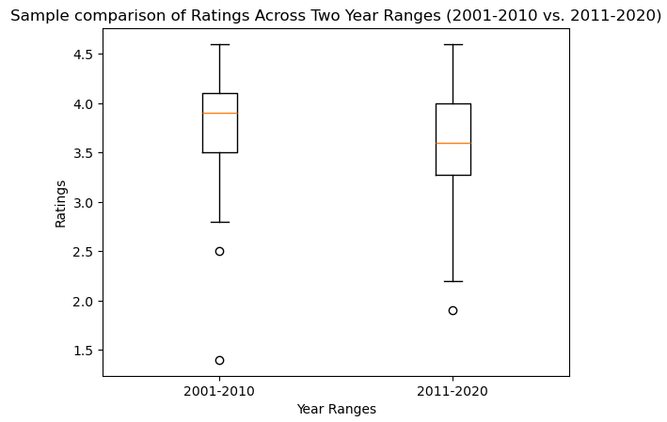
Exploratory Data Analysis
Prashil Patel
Notes:
Histogram plots
First graph:
data of ratings is between 3-4.25
Highest Peak at 4
Lowest at 1.5, max at 4.5
Second Graph:
Data is more spread but still around 3-4
Peak at 3.5
Lowest at 2, highest at 4.5
Box plot for better comparison
50% of data is between 3.5-4.0, mean closer to 4
50% of data between 3.4-3.9, mean closer to 3.5

Slide 8

Conclusion
Games created between 2001-2010 have better player rated games compared to releases in 2011-2020
Companies should consider older concepts in games compared to newer games.
Prashil Patel
Notes:
We have strong evidence that games released in 2001-2010 are rated higher compared to games released in 2011-2020
Companies should look at older concepts and implement them in games to create potentially better revenue and better rated games
Could be due to simplicity sakes from personal experience

Slide 9
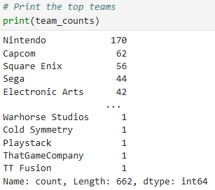
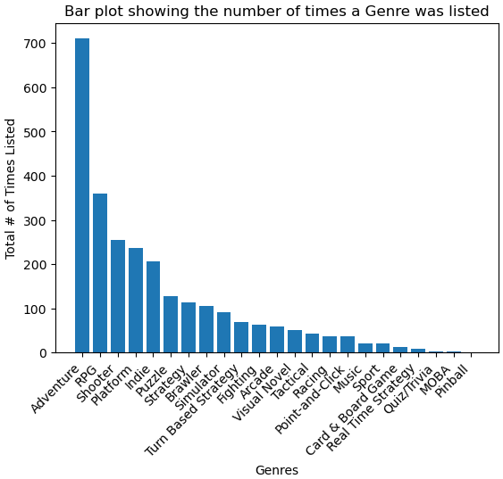

Bonus
Prashil Patel
Notes:
Just as a bonus i thought id look at the most common genres from the games and also the team that produced the most games
Keeping in mind, more than one genre and team fit a single game

Slide 10

Future Improvements
Fill null genre values using previous iterations of the game
Fill null rating values with mean value from same genre
Prashil Patel
Notes:
Future things id like to take in consideration and add in my analysis
Fill null genre values using previous iterations of games
FIll null rating values with mean values from same genres

